Slide 1


BRIAN GRADIN
• jonathan haas
• Ellie janzen
• ethan moffaT
March 2014
CS 4151
Notes:
Games are fun
MMO: (Massively) Multiplayer Online
Something different
Limited resources – roadblock or opportunity?

Slide 2
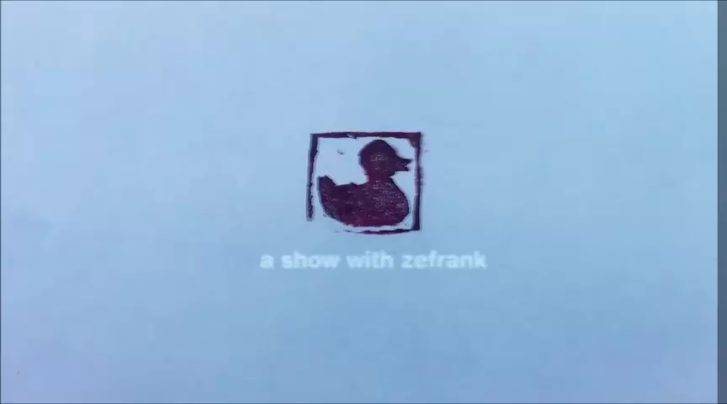

Slide 3
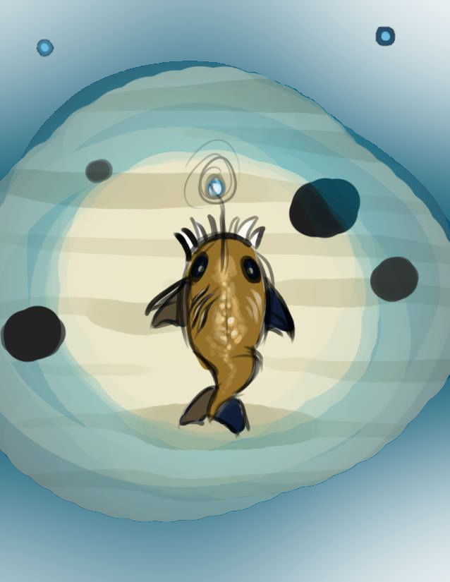


So You’re a Fish
MMO - Deep sea theme
Navigate a maze, limited light, collect bacteria
Fun, challenging, simple mechanics
Easy to expand
MMO - Deep sea theme
Navigate a maze, limited light, collect bacteria
Fun, challenging, simple mechanics
Easy to expand

Slide 4
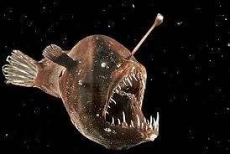
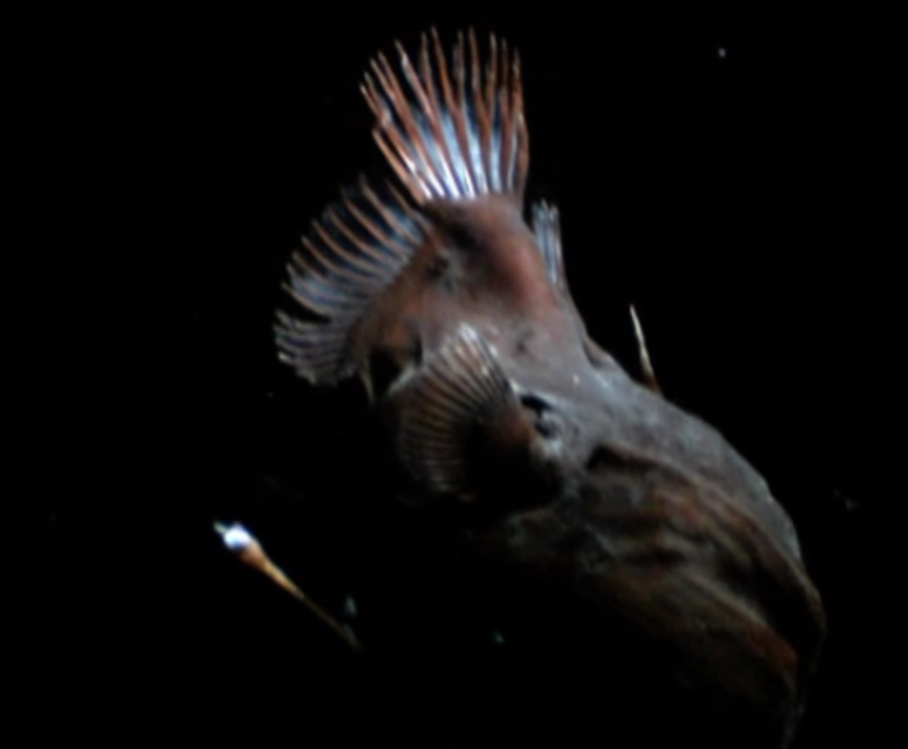
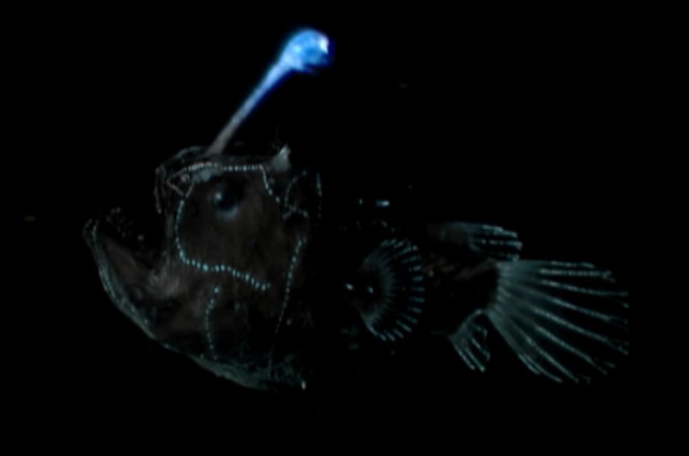

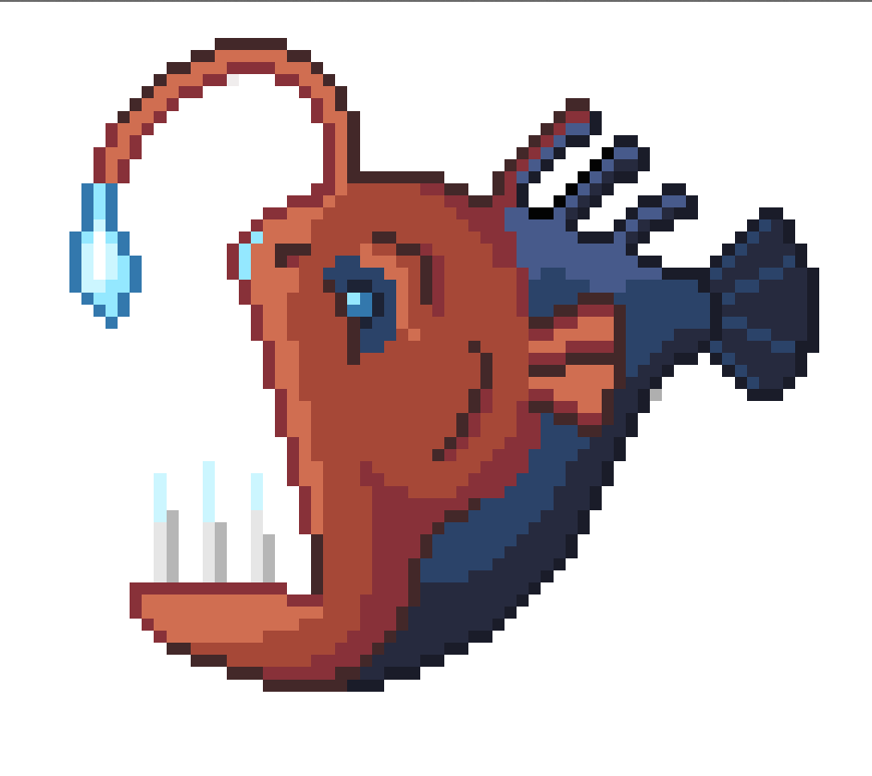
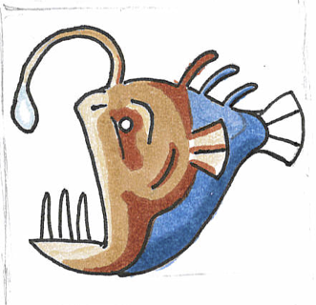
Creating Graphics
4 fish
3 bacteria
8 walls
33 trenches
23 backgrounds

Slide 5

























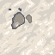








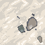
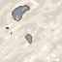
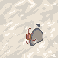
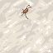









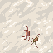
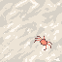
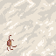

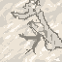


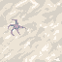







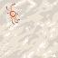
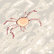








Slide 6
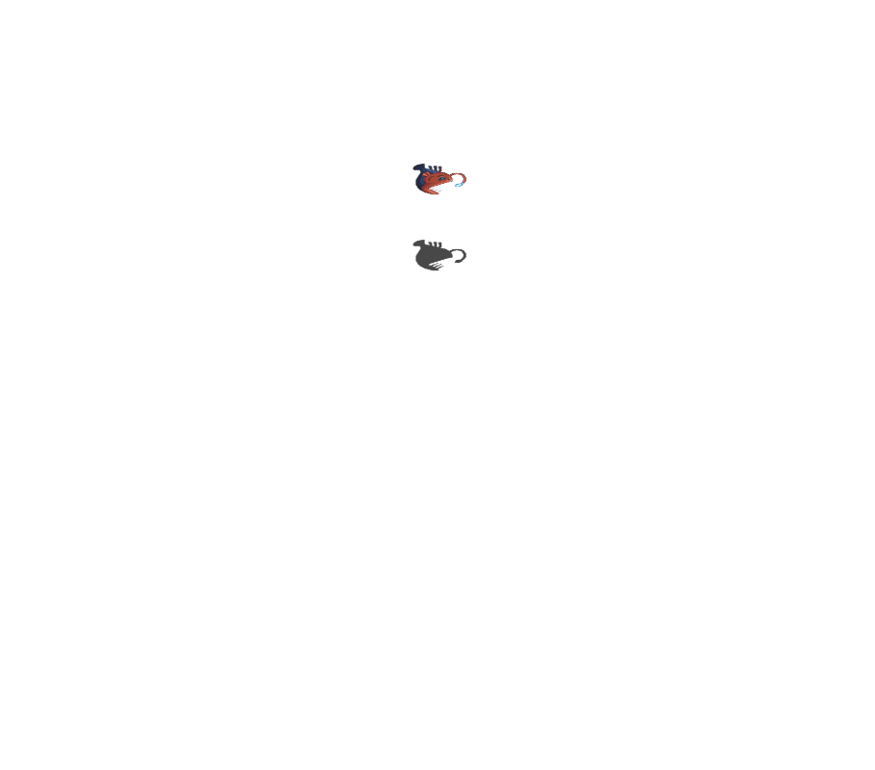
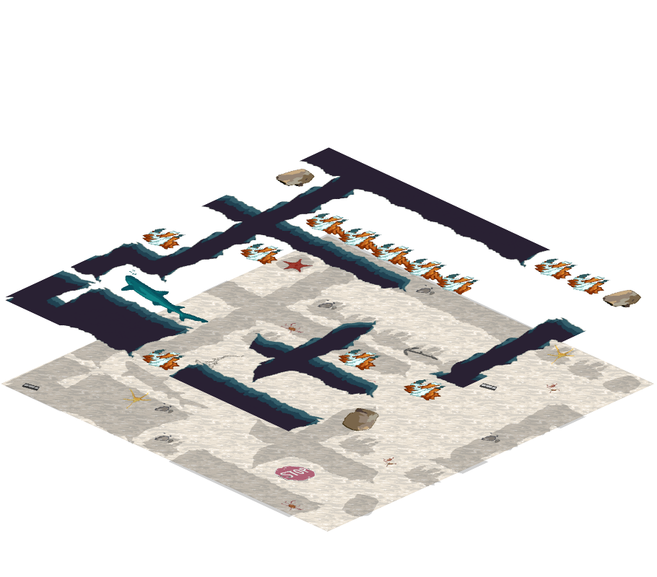
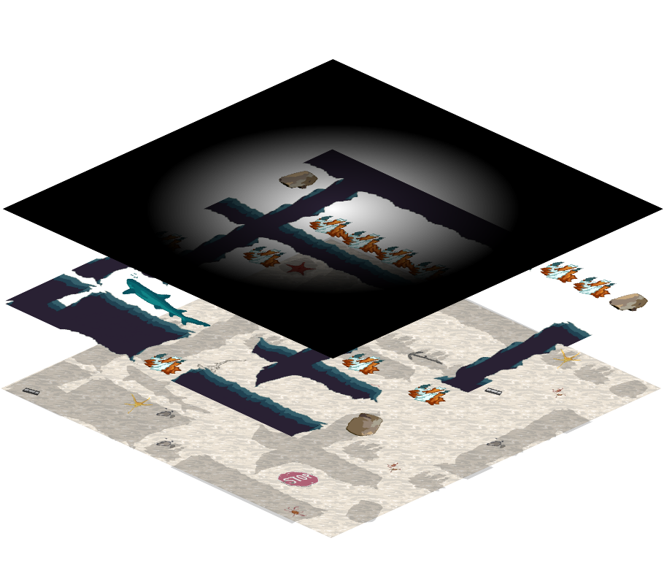
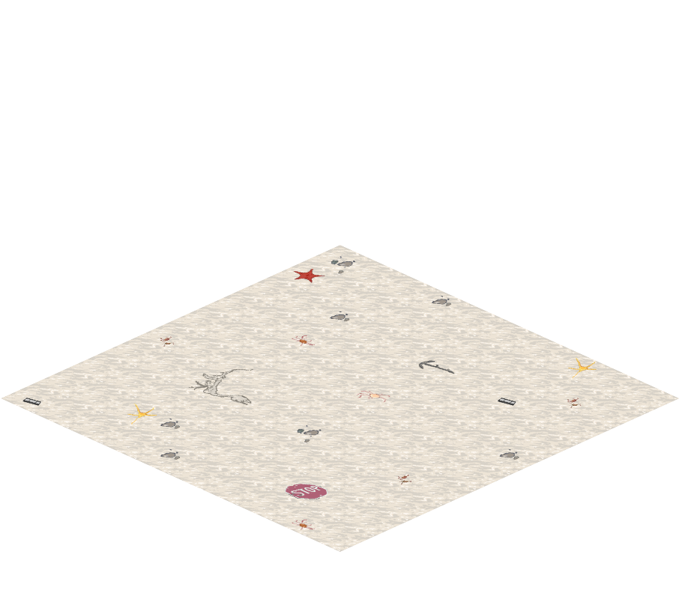
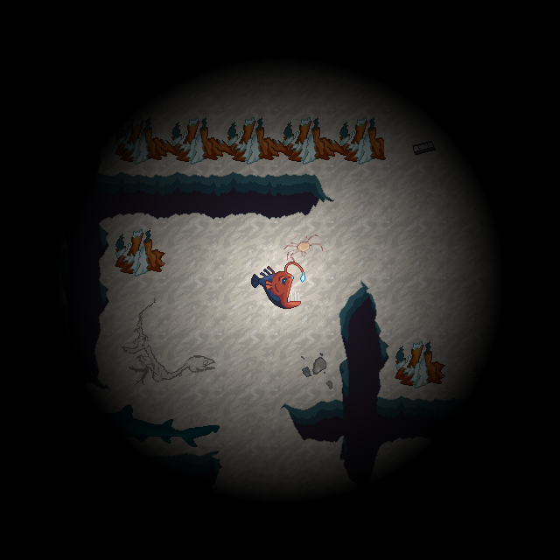
Tile-based, layered graphics

Slide 7
demonstration

Slide 8




System Environment
XNA Game Studio
.NET Framework 4.0
Windows 7 or later
Windows Server 2008 R2
XNA Game Studio
.NET Framework 4.0
Windows 7 or later
Windows Server 2008 R2

Slide 9




Development Tools
Customized Map Editor
Plaintext map format was unfeasible
Custom map object prevents editing
Tileset stores graphics
WYSIWYG
GIMP
Perforce
Customized Map Editor
Plaintext map format was unfeasible
Custom map object prevents editing
Tileset stores graphics
WYSIWYG
GIMP
Perforce
C#
Easy to Use
Extensible
XNA Game Development Library (Microsoft)
Convenient Framework
Community Support
C#
Easy to Use
Extensible
XNA Game Development Library (Microsoft)
Convenient Framework
Community Support

Slide 10
Lessons Learned
XNA
Limits
Optimization
Graphics
Effects
Shadows
Sound
Manipulation through Audacity
Creating sound effects
File formats
UI Controls
Game Component Model
Debugging network and threaded code
Pixel Art
UML diagramming/documentation
XNA
Limits
Optimization
Graphics
Effects
Shadows
Sound
Manipulation through Audacity
Creating sound effects
File formats
UI Controls
Game Component Model
Debugging network and threaded code
Pixel Art
UML diagramming/documentation

Slide 11


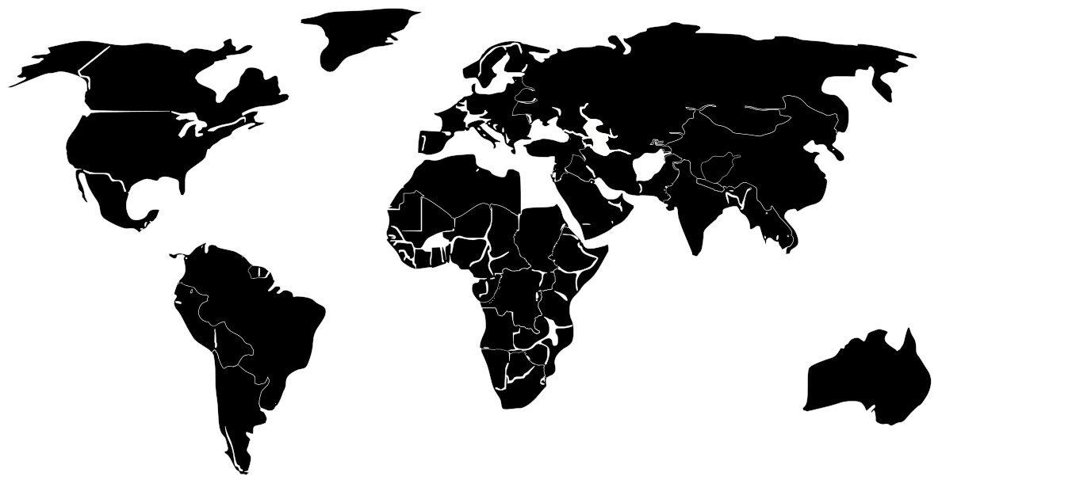
System Future
Non-playable characters
Mobile enemies
Shop keepers
Inventory items
Multiple maps/zones
Non-playable characters
Mobile enemies
Shop keepers
Inventory items
Multiple maps/zones

Slide 12
Questions?

